Slide 2
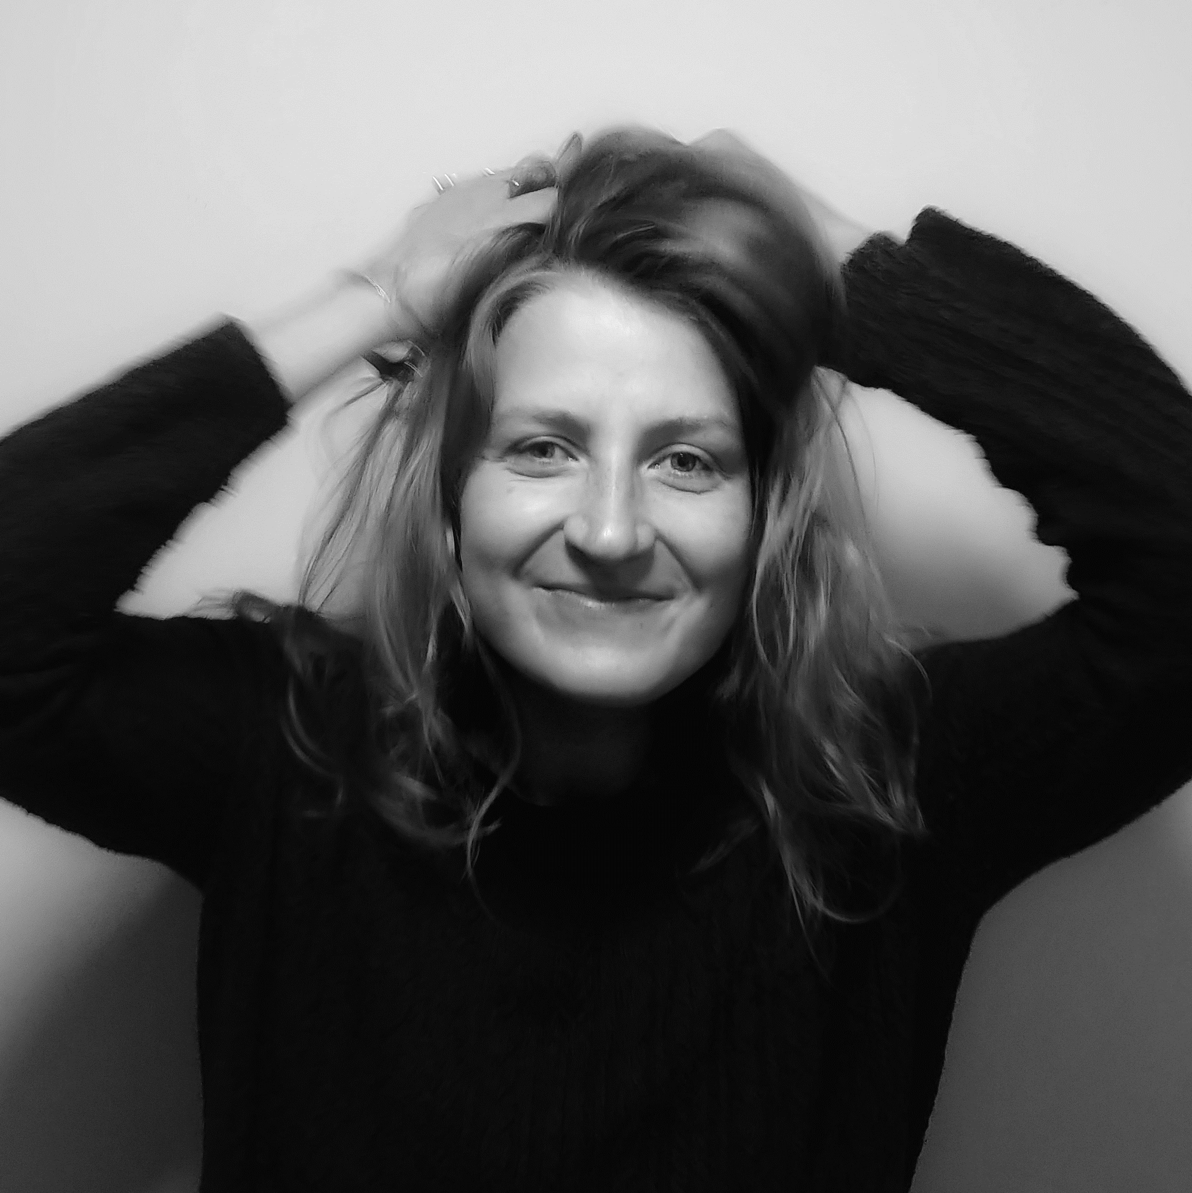

Slide 3

Meet the team #4
Celia

Slide 4
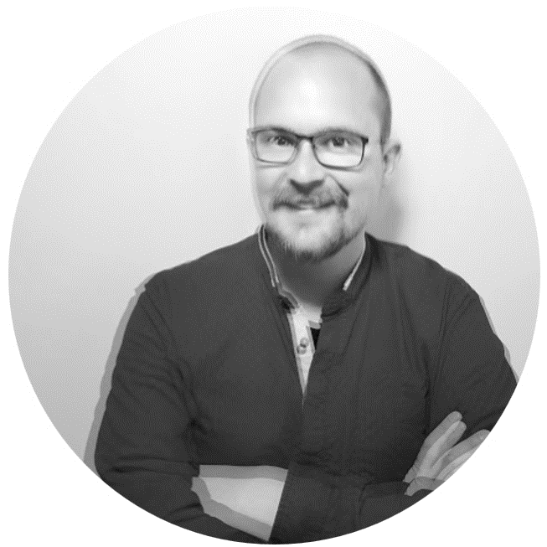

Slide 5
Meet the team #5
jan

Slide 6
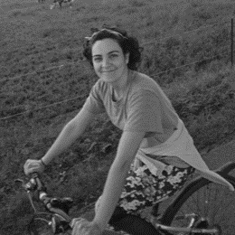

Slide 7
Meet the team #6
Cristina

Slide 8


Slide 9
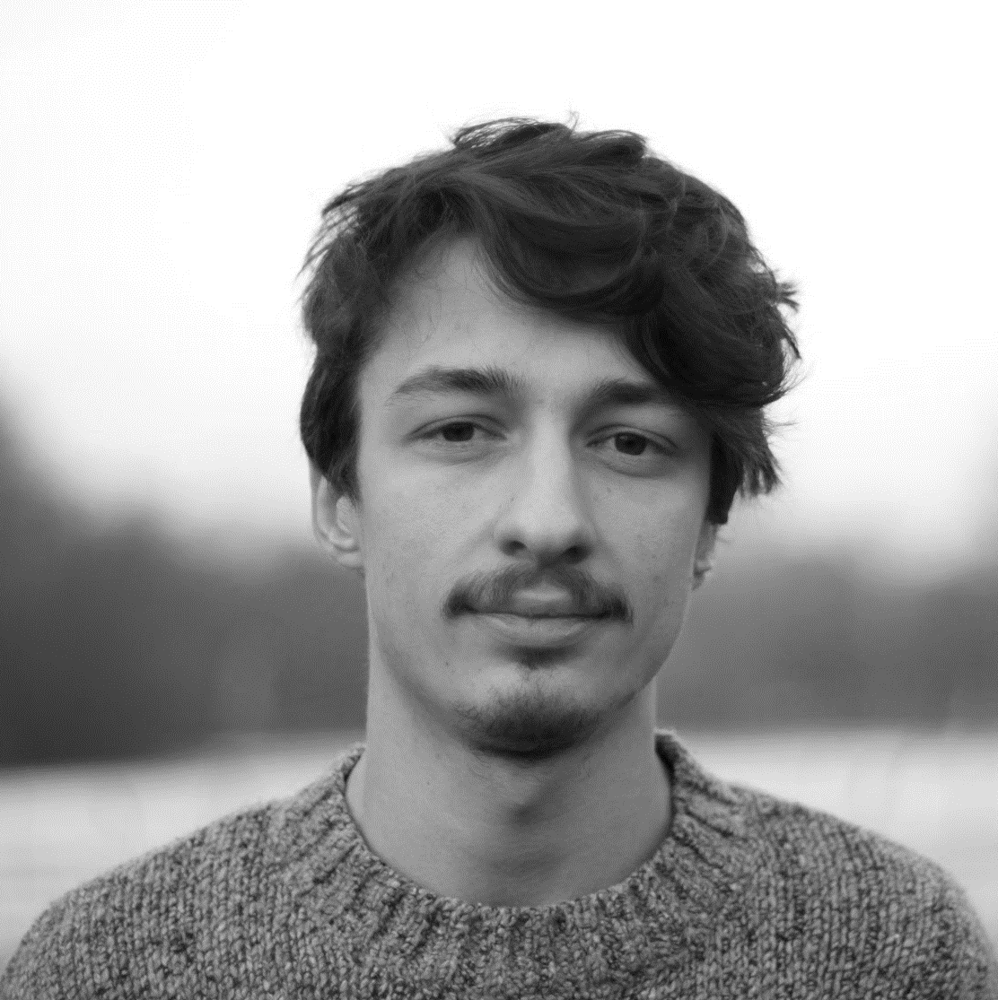

Slide 10
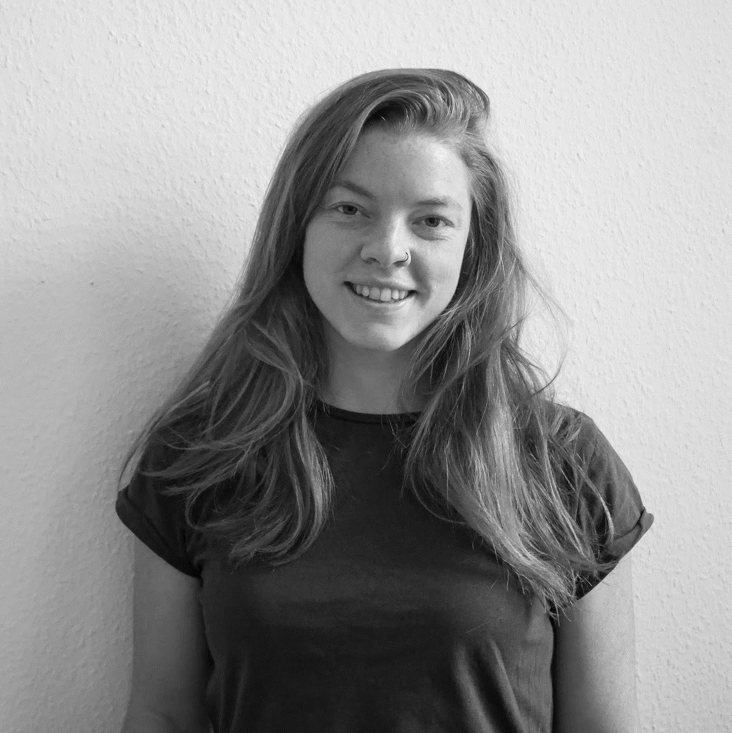

Slide 11
Meet the team #2
Susan

Slide 13
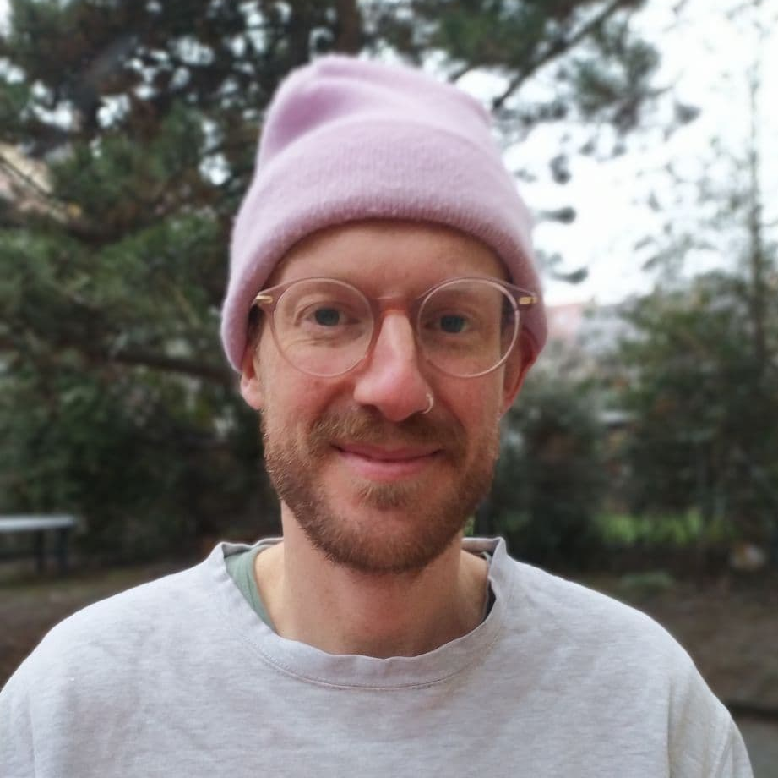

Slide 14
Meet the team #2
Christian

Slide 15


Slide 16
Meet the team #3
Jonas

Slide 17
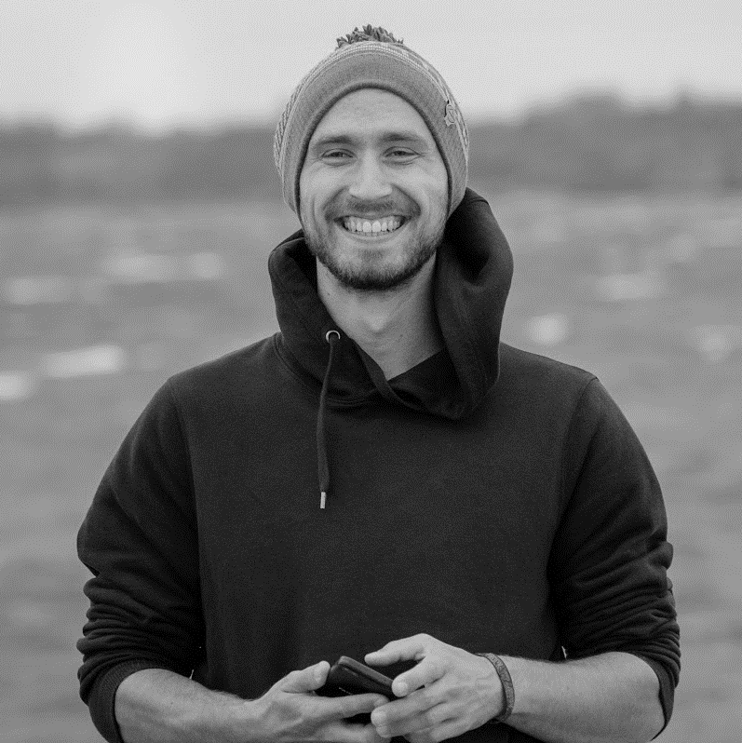

Slide 18
Meet the team #1
PHIL

Slide 19
What is
Precious
Plastic?

